Slide 1
Phased array patch antenna @10GHz
Objective: “Design a 1D patch phased array of 10 elements with corporate feeding network for broadside radiation, target return loss is -10 dB. Calculate the radiation pattern analytically and numerically and compare them. If you want you can select the operating frequency yourself, otherwise use 10 GHz.”

Slide 2
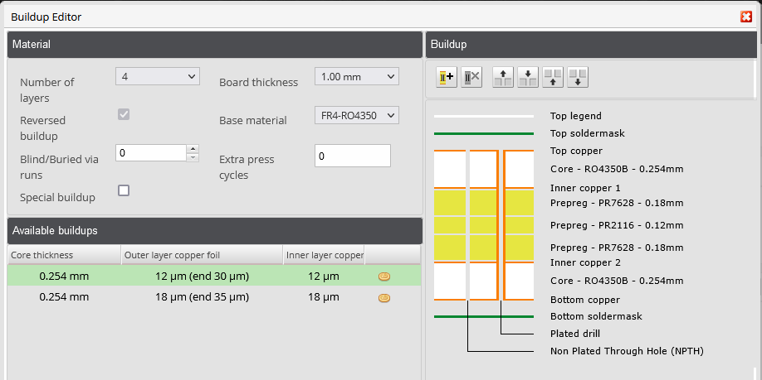
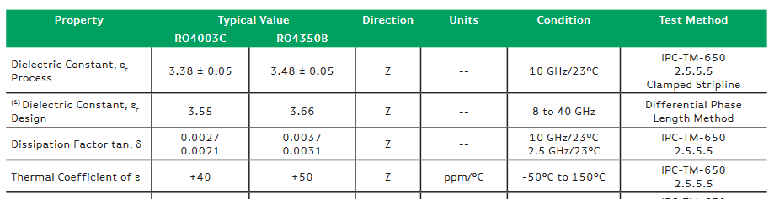
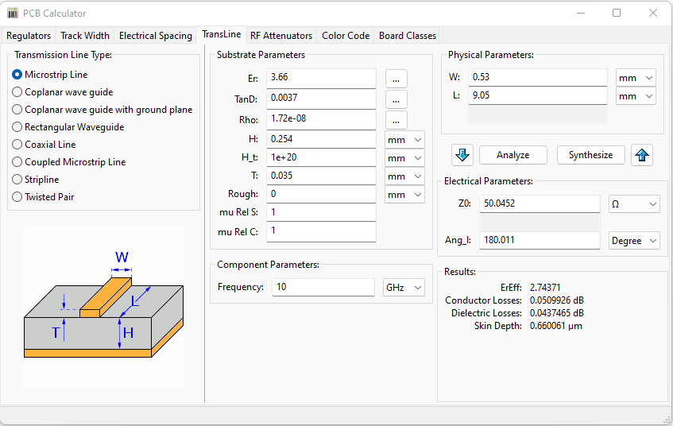
Stack-up
Find an industrialized stack-up so that the design can be fabricated.
4-layer stack-up allows having thin substrate, hence thin feeding microstrip line.
RO4350B chosen for lower dielectric loss

Slide 3
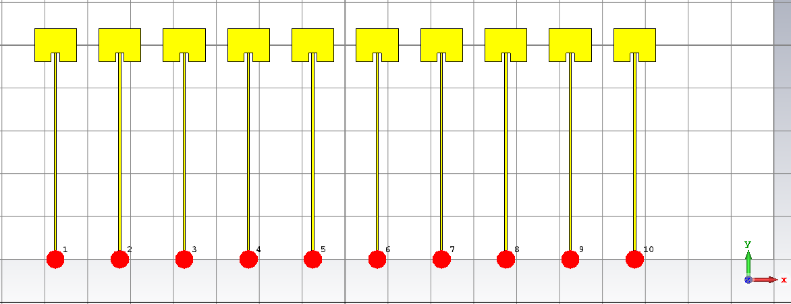

Intended design
The patch array antenna is designed as follow:
Broadside direction toward +Z
Feeding comes from –Y toward +Y
Array’s elements placed 1D along X and have distance $\frac{λ_{0}}{2}$

Slide 4
Analytical estimation of 1x10 patch array

Slide 5
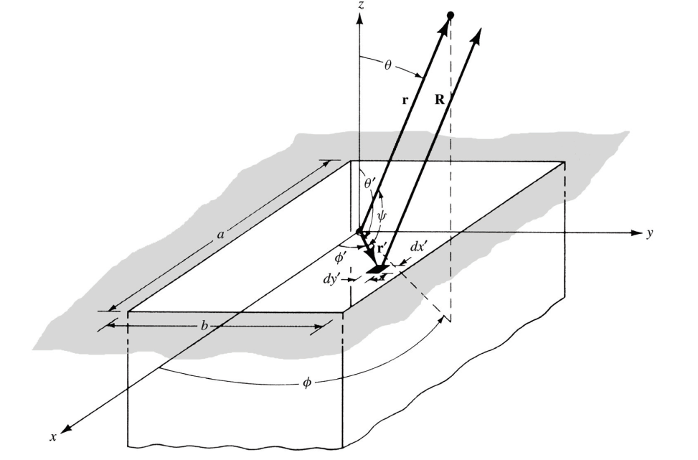
Analytical analysis of the array
Cavity model of the element patch antenna
TM₀₁₀ as dominant mode
The following is MATLAB calculation from Balanis for the intended design (chapter 14)
INPUT PARAMETERS
================
RESONANT FREQUENCY (in GHz) = 10.0000
DIELECTRIC CONSTANT OF THE SUBSTRATE = 3.6600
HEIGHT OF THE SUBSTRATE (in cm) = 0.0254
POSITION OF THE RECESSED FEED POINT (in cm) = 0.2000
OUTPUT PARAMETERS
=================
PHYSICAL WIDTH OF PATCH (in cm) = 0.9827
EFFECTIVE LENGH OF PATCH (in cm) = 0.8027
PHYSICAL LENGH OF PATCH (in cm) = 0.7785
E-PLANE HPBW (in degrees) = 136.0000
H-PLANE HPBW (in degrees) = 80.0000
DIRECTIVITY OF RECTANGULAR PATCH (dimensionless) = 4.2200
DIRECTIVITY OF RECTANGULAR PATCH (in dB) = 6.2531
RESONANT INPUT RESISTANCE AT LEADING RADIATING EDGE (y=0) Rin0= 293.4669 ohms
RESONANT INPUT RESISTANCE AT RECESSED FEED POINT (y=0.2000 cm) RINYo= 140.3699 ohms
*** NOTE:
THE E-PLANE AMPLITUDE PATTERN IS STORED IN Epl-Micr_m.dat
THE H-PLANE AMPLITUDE PATTERN IS STORED IN Hpl-Micr_m.dat
=========================================================

Slide 6
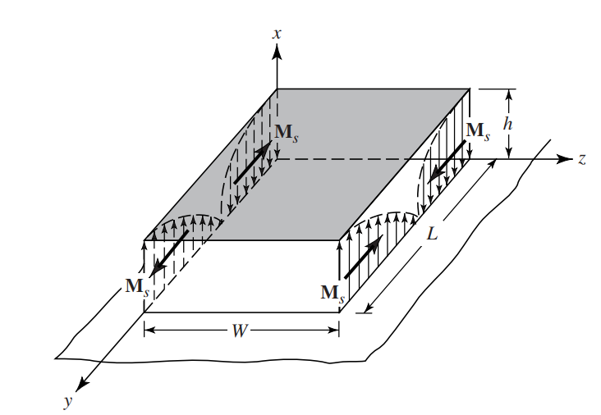
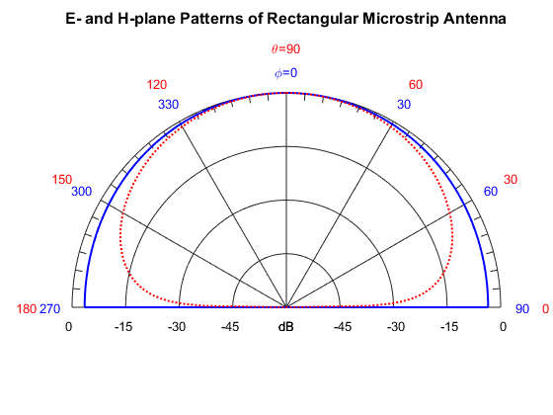
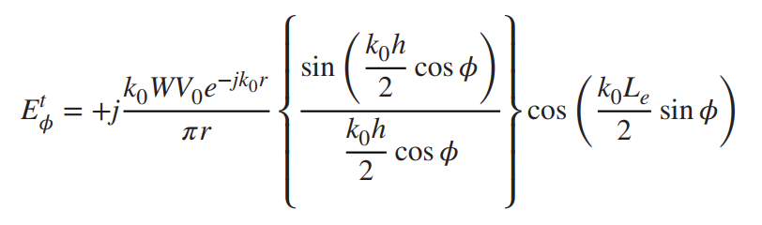
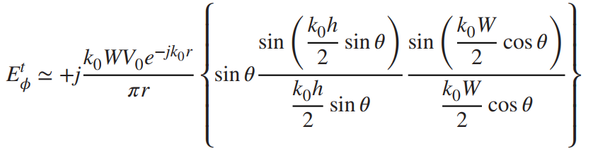



Analytical analysis of the array
Analytical pattern calculated by Balanis for X-direction broadside
E-plane ($θ={90}^{o}$)
H-plane($φ=0^{o}$)
E-plane ($θ={90}^{o}$)
H-plane ($φ=0^{o}$)

Slide 7
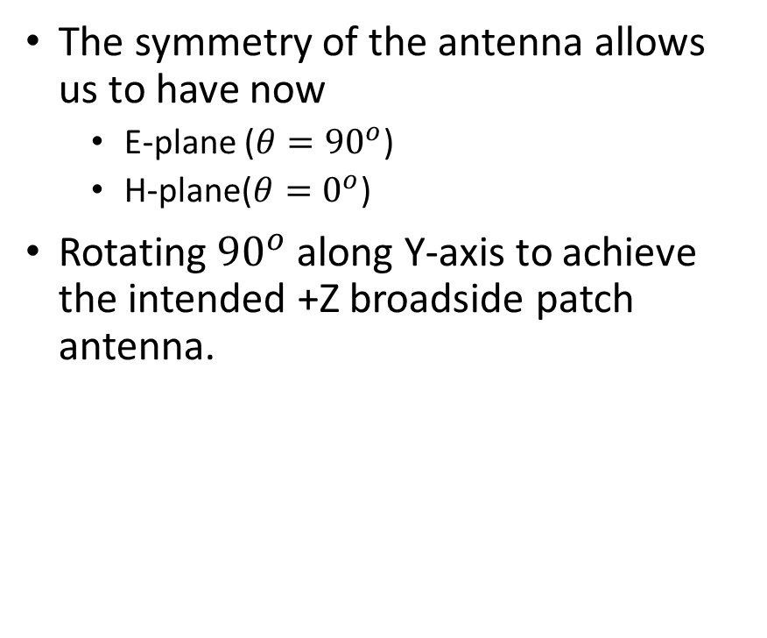



Analytical analysis of the array
The symmetry of the antenna allows us to have now
E-plane ($θ={90}^{o}$)
H-plane($θ=0^{o}$)
Rotating ${90}^{o}$along Y-axis to achieve the intended +Z broadside patch antenna.
$$θ$$
E-plane ($φ={90}^{o}$)
H-plane ($φ=0^{o}$)

Slide 8
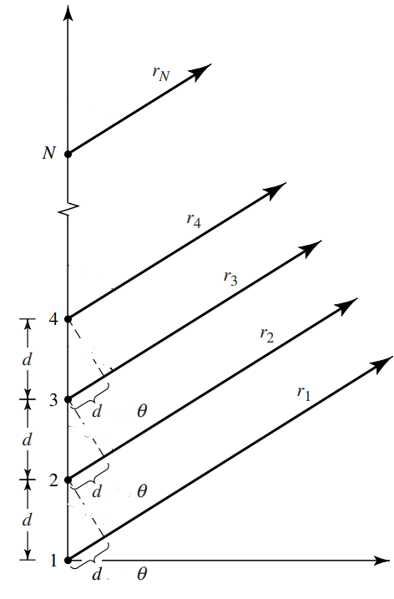
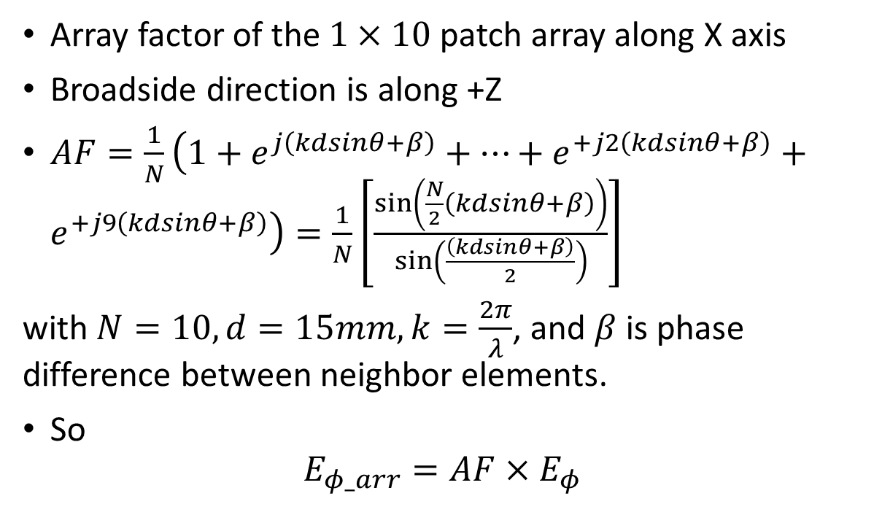




Analytical analysis of the array
x
Array factor of the $1×10$patch array along X axis
Broadside direction is along +Z
$AF=\frac{1}{N}\left(1+e^{j\left(kdsinθ+β\right)}+…+e^{+j2\left(kdsinθ+β\right)}+e^{+j9\left(kdsinθ+β\right)}\right)=\frac{1}{N}\left[\frac{sin⁡\left(\frac{N}{2}\left(kdsinθ+β\right)\right)}{sin⁡\left(\frac{\left(kdsinθ+β\right)}{2}\right)}\right]$
with $N=10, d=15mm,k=\frac{2π}{λ}$, and $β$ is phase difference between neighbor elements.
So
$$E_{φ_arr}=AF×E_{φ}$$
$$sin⁡$$
$$sin⁡$$
$$θ$$
z
$$sin⁡$$

Slide 9
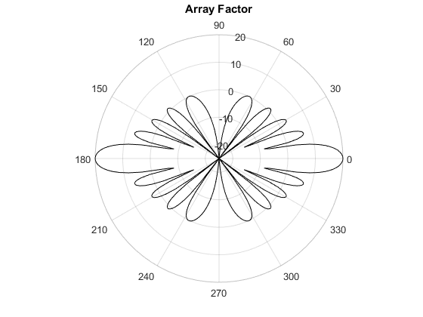
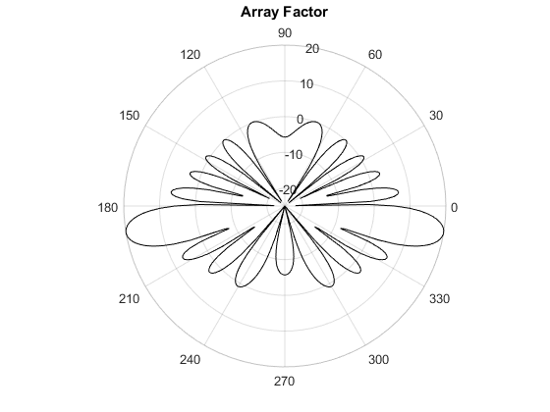
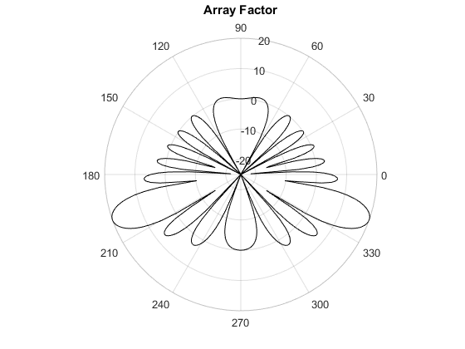
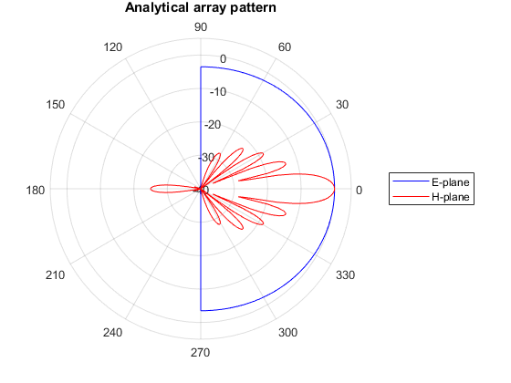
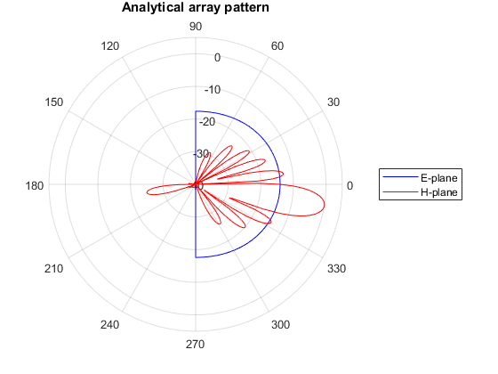
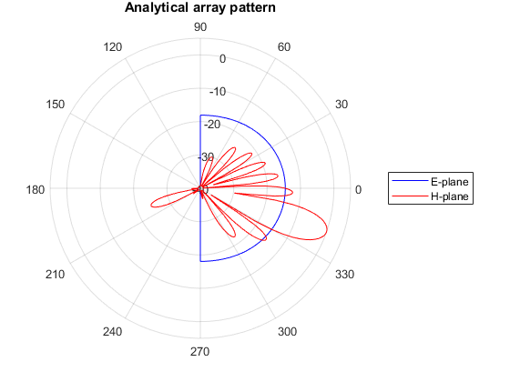



Analytical analysis of the array
$$β=0^{o}$$
$$β={30}^{o}$$
$$β={60}^{o}$$

Slide 10
Numerical estimation of 1x10 patch array

Slide 11
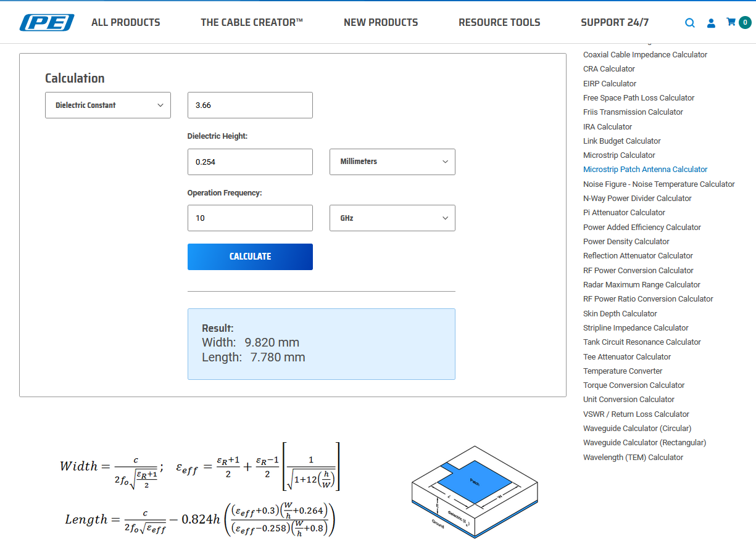
Patch array design
Using online tool to calculate patch dimension.

Slide 12
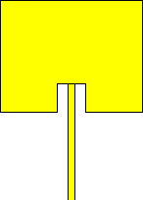

Numerical simulation CST
Recessed microstrip-line feed point to have a better impedance matching
Making array with distance $λ_{air}$/2 = 15mm and with separate ports
Phase excitation is controlled by simulator
Microstrip line width is 0.53mm
2mm
7.75mm
2mm
9.82mm
Single patch design
1x10 patch array design

Slide 13
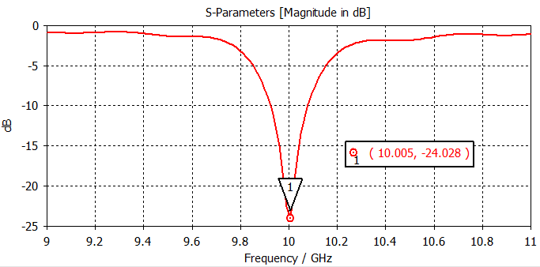
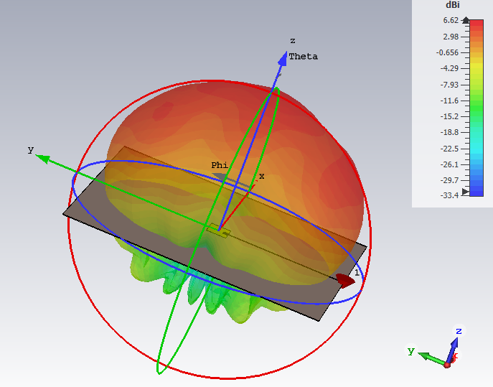
Numerical simulation CST
2mm
7.75mm
2mm
Simulation of single patch
9.82mm
3D radiation pattern of single patch
Single patch design
Impedance matching of single patch

Slide 14
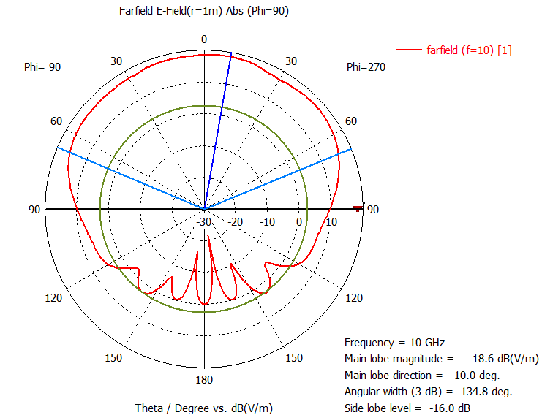
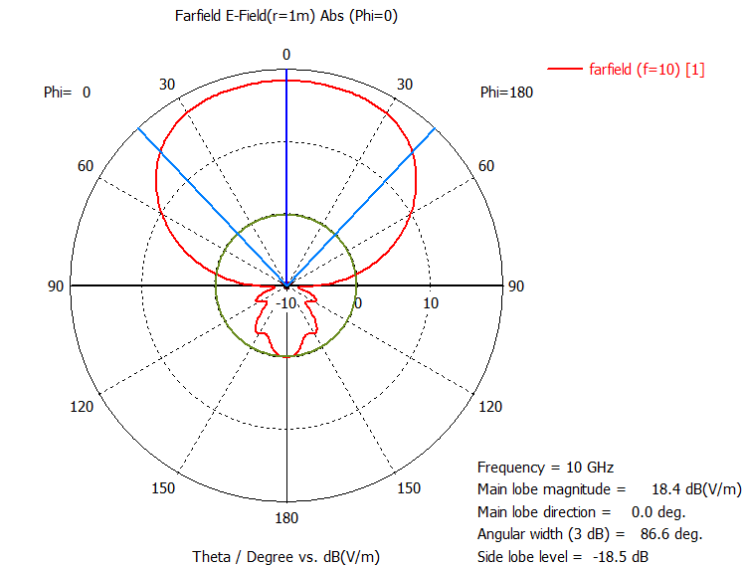
Numerical simulation CST
2mm
7.75mm
2mm
Simulation of single patch
9.82mm
Single patch design
E-plane
H-plane

Slide 15
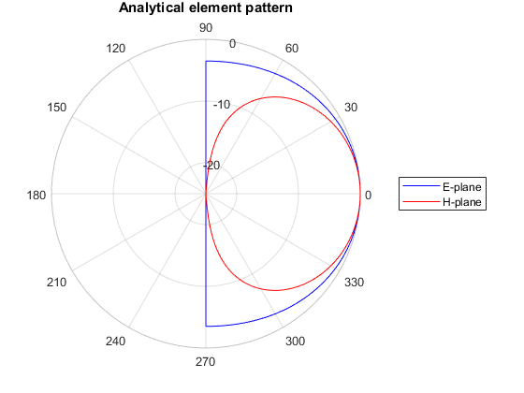
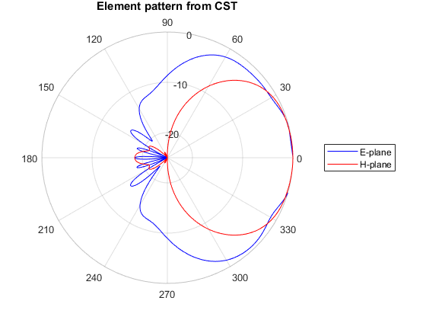
Numerical simulation CST
2mm
7.75mm
2mm
Simulation of single patch versus analytical results
Directivity = 6.62 dBi (versus 6.25 dBi of analytical result)
E-plane HPBW = 134.8º (versus 136º of analytical result)
H-plane HPBW = 86.6º (versus 80º of analytical result)
9.82mm
Single patch design
*back radiation due to finite ground plane

Slide 16
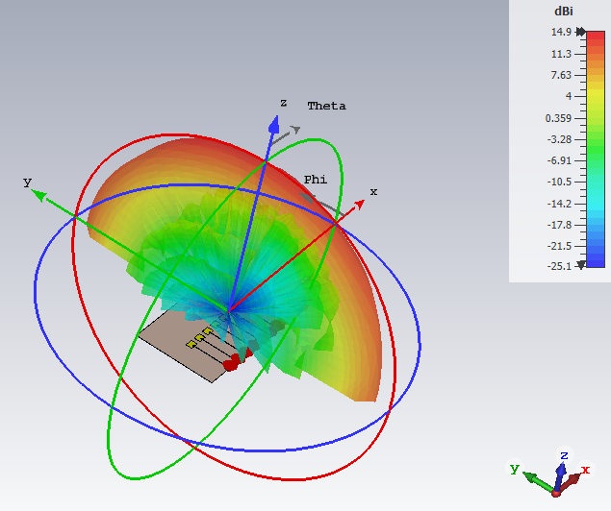
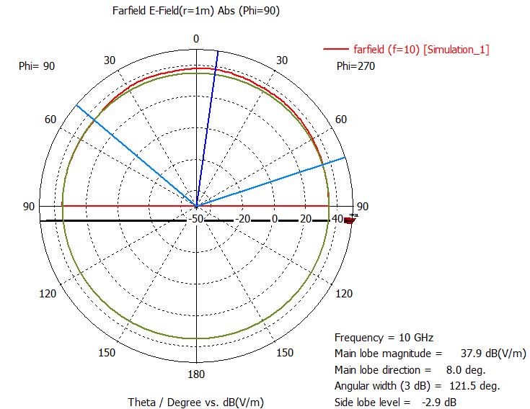
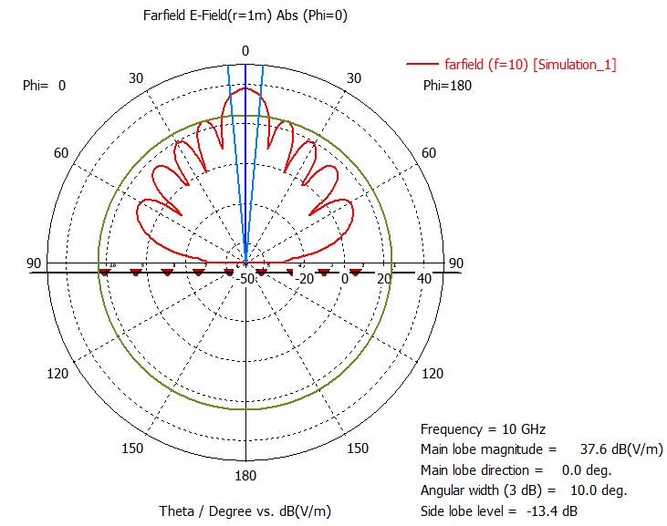

Numerical simulation CST
Simulation of 1x10 patch array ($β=0^{o}$)
Array directivity
E-plane
H-plane

Slide 17
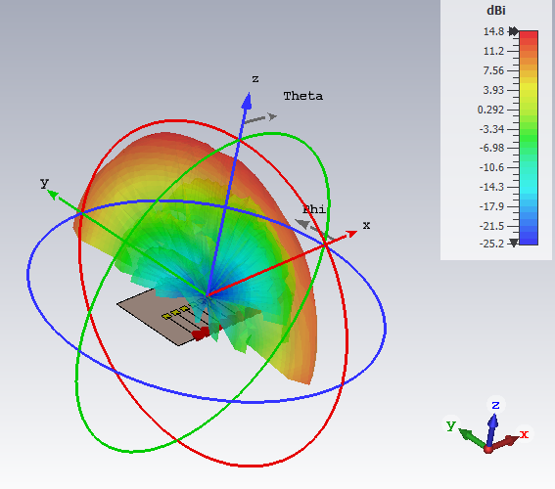
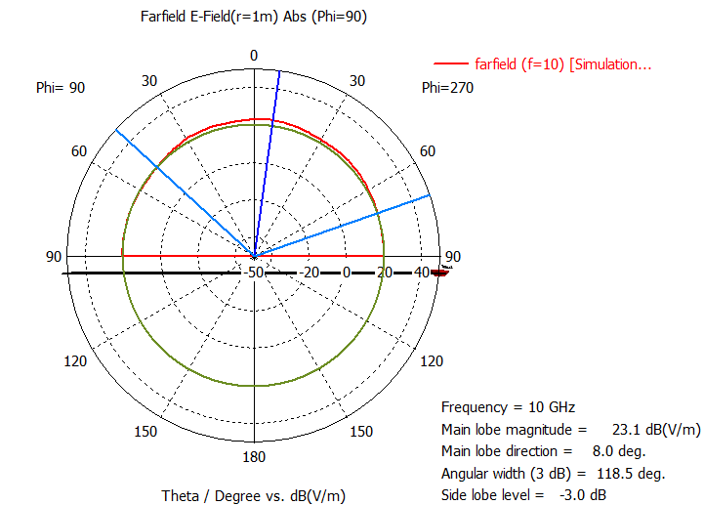
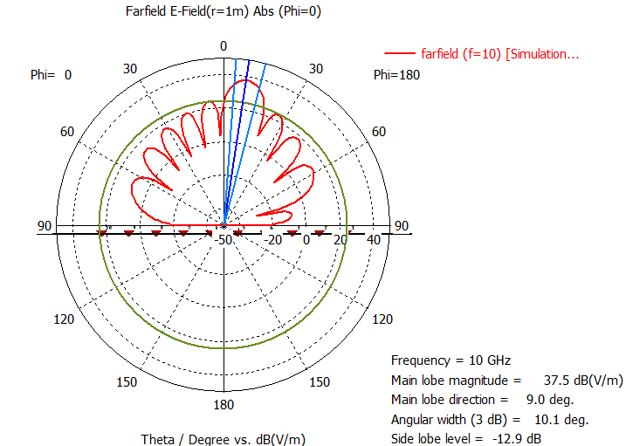

Numerical simulation CST
Simulation of 1x10 patch array ($β={30}^{o}$)
Array directivity
E-plane
H-plane

Slide 18
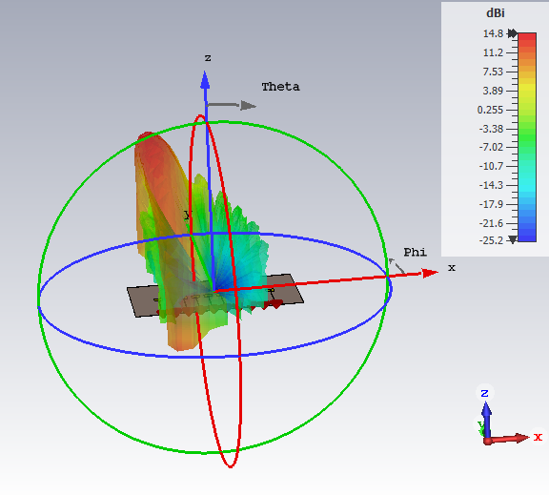
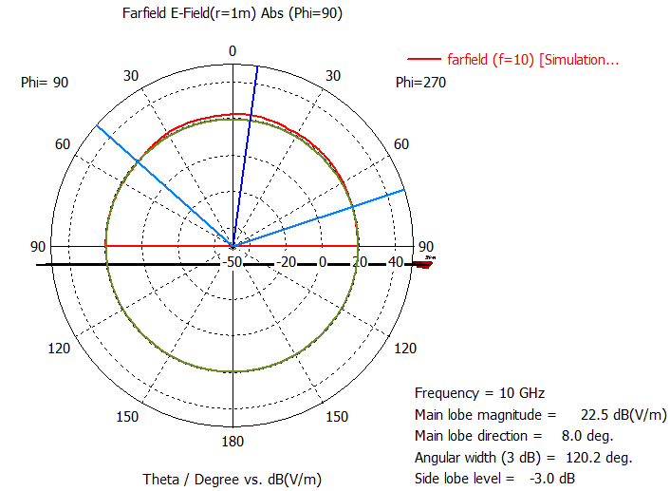
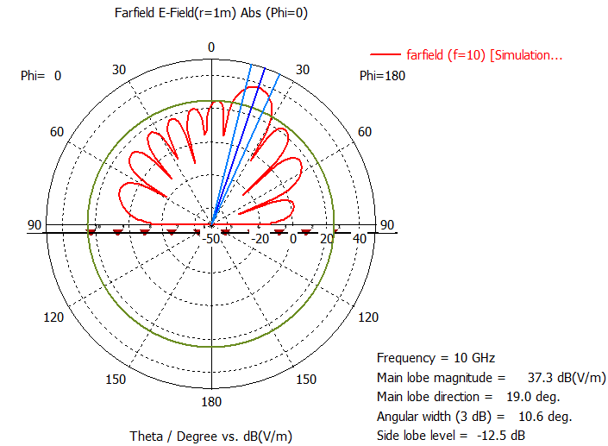

Numerical simulation CST
Simulation of 1x10 patch array ($β={60}^{o}$)
E-plane
H-plane

Slide 19
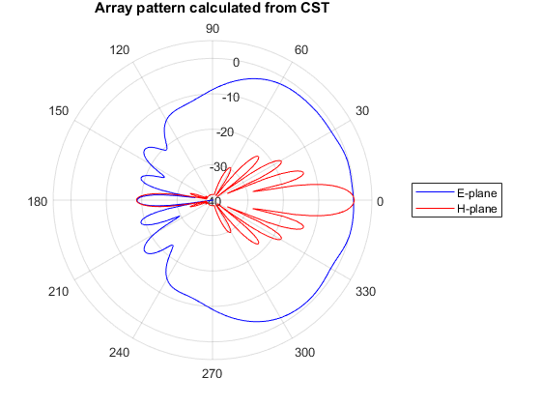
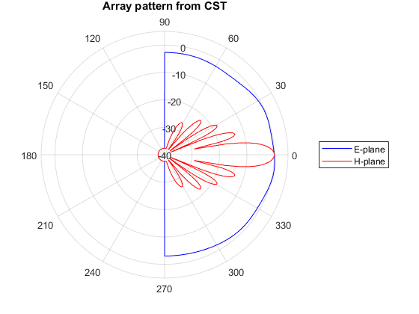
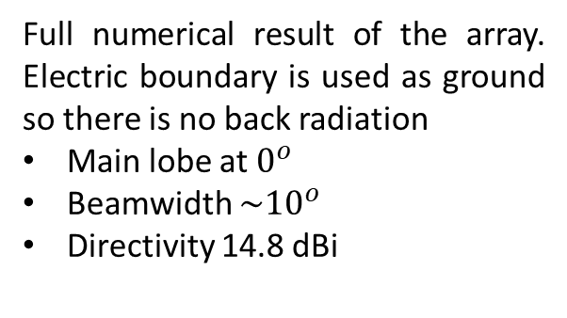

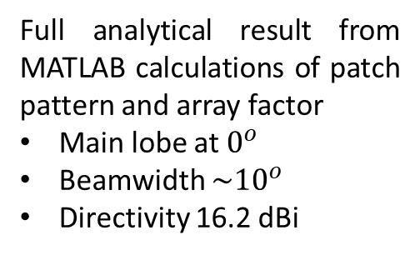
Comparison $β=0^{o}$
Full analytical result from MATLAB calculations of patch pattern and array factor
Main lobe at $0^{o}$
Beamwidth ${\sim 10}^{o}$
Directivity 16.2 dBi
Partially analytical result from numerical patch pattern and MATLAB calculation array factor
Close to full analytical results
Full numerical result of the array. Electric boundary is used as ground so there is no back radiation
Main lobe at $0^{o}$
Beamwidth ${\sim 10}^{o}$
Directivity 14.8 dBi

Slide 20
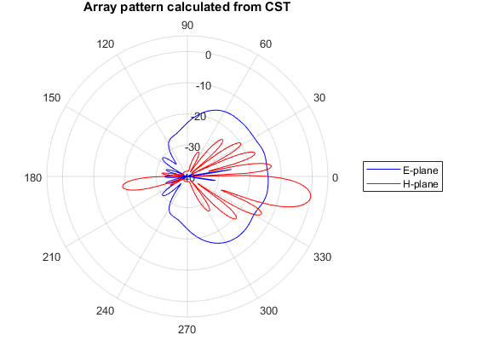
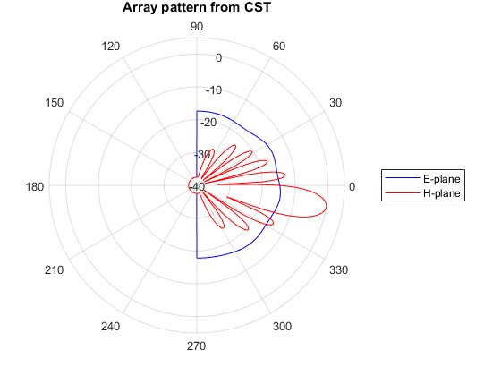
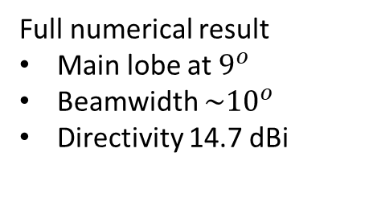
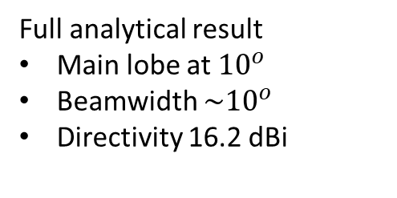

Comparison $β={30}^{o}$
Full analytical result
Main lobe at ${10}^{o}$
Beamwidth ${\sim 10}^{o}$
Directivity 16.2 dBi
Partially analytical result
Close to full analytical results
Full numerical result
Main lobe at $9^{o}$
Beamwidth ${\sim 10}^{o}$
Directivity 14.7 dBi

Slide 21

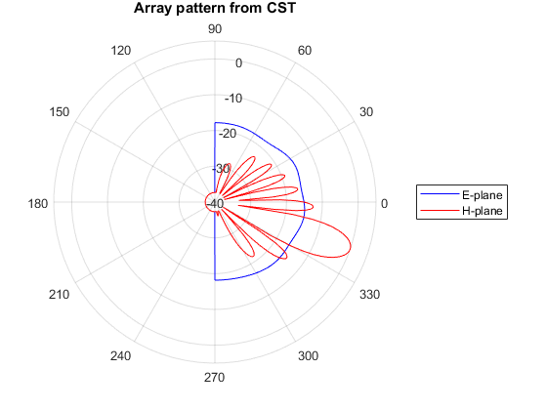



Comparison $β={60}^{o}$
Full analytical result
Main lobe at $20^{o}$
Beamwidth ${\sim 10}^{o}$
Directivity 16.2 dBi
Partially analytical result
Close to full analytical results
Full numerical result
Main lobe at ${19}^{o}$
Beamwidth ${\sim 10}^{o}$
Directivity 14.8 dBi

Slide 22
Conclusion
The numerical results of separating-element array are quite close to either full or partial analytical results if we ignore the back radiation (depends on ground plane side), in terms of
Direction of main lobe
Direction and number of nulls
Beamwidth
Directivity
The asymmetry of the feed, the finite dimension of the ground in simulation can introduce some differences in the single element pattern and hence array pattern.

Slide 23
Design of feeding network

Slide 24
Feeding network
To produce the difference in phase excitation of each element of the array we can
Use some active components, such as phase-shifter.
Normally requires complicated control.
Need to design a DC part that doesn’t couple with RF part
Passive feeding network, like
Butler matrix, need power-two (2^{x}) number of input and output
Rotman lens allows have any number of antenna port.

Slide 25



Rotman lens for feeding network
10 array ports (connect to antennas)
9 beam ports (excitation ports)
8 dummy ports ($50Ω$ loads)
30º phase shift

Slide 26




ROTMAN import CST
Phase differences are not perfectly produced as intended by the Rotman lens
Excitation of port 5:${\sim 0}^{o}$
Excitation of port 4 and 6: $\sim {30}^{o}$
Excitation of port 3 and 7: $\sim {50}^{o}$
…
All ports have better Return Loss than -12dB
Expecting up to 6dB loss due to the Rotman lens

Slide 27


Final design
Some microstrip line phase-shifters are introduced and optimized to produce a phase balance at every antenna port.
Simulation takes long time on a 16Gb RAM laptop and cannot run very fine meshes.

Slide 28






Results
Excitation to Port 5 (in the middle)
Main lobe at $0^{o}$
Beamwidth ${\sim 10}^{o}$
Directivity 14.24 dBi
Excitation to Port 4
Main lobe at $7^{o}$
Beamwidth ${\sim 10}^{o}$
Directivity 14.07 dBi
Excitation to Port 3
Main lobe at ${15}^{o}$
Beamwidth ${\sim 10}^{o}$
Directivity 14.42 dBi

Slide 29

Results
Directivity and HPBW of the final design are similar to that of analytical and separating element design.
Phase difference is smaller and varying making the angle of the main lobe smaller.
Because the feeding network is not perfect, the pattern is not clean as the analytical synthesis or numerical result in which there is no feeding network.

Slide 30

Perspective
This is a preliminary design, refinements are required on
Fine mesh simulations
Optimizing the Rotman lens to obtain ${Δ30}^{o}$ step
Optimizing the microstrip phase-shifters
Finalize the feeding ports to SMA

Slide 31
References
Eurocircuits site: https://www.eurocircuits.com/
Balanis, “Antenna Theory: Analysis and Design,” 4th edition, MATLAB code: https://fr.mathworks.com/academia/books/antenna-theory-balanis.html
Rotman lens design using MATLAB: https://fr.mathworks.com/matlabcentral/fileexchange/50490-rotman-lens-design-with-hfss-link?s_tid=mwa_osa_a
Patch dimension calculator: https://www.pasternack.com/t-calculator-microstrip-ant.aspx
Microstrip line calculator: https://www.pasternack.com/t-calculator-microstrip.aspx

